Slide 1

AI and AR:
(Re-)engineering a brain
Joakim Pettersson

Slide 2
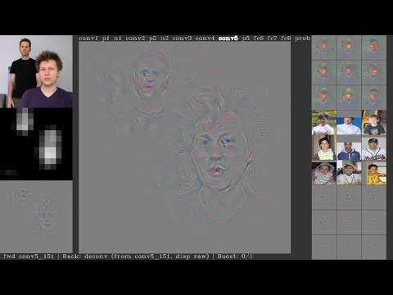
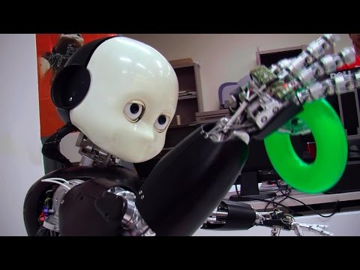
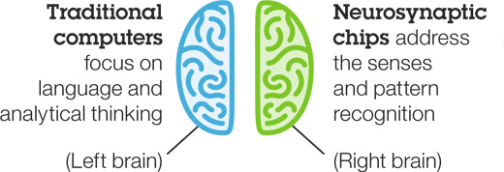
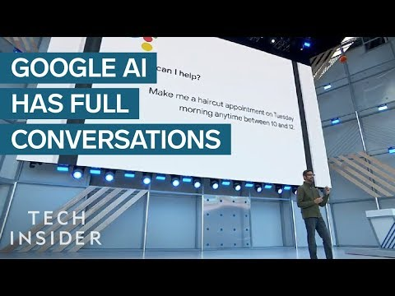


Welcome
Why are we here?
Notes:
Want to see actual real-time communication with an artificial intelligence, and how it happens? Top right - Do you think my shirt has wrinkles? Middle left - Can you balance this ball? Bottom left - Can you just drop-in [instead of reserving a place]?

Slide 3
Content
Content
Terminology: What is AI and AR?
Training: What data to use?
What tools to use?
What hardware to use?
What’s going on with AR?
What about the future?
Discussions
nVidia AI and Tobii AR trial/demo

Slide 4
Terminology
What is AI, AR and AGR?
Training data
History of input X and wanted output Y
AI = Artificial Intelligence
Model the unseen x-y from the seen X-Y
Radial basis: y = f(x - X) Y / sum(f(x - X))
Deep learning: y = f(K1 f(K2 f(K3 x + m3) + m2) + m1)
Recurrent: y = f(C y + K x + m)
Spiky: y = f(C y + K dx/dt + m)
AR = Augmented Reality
Sharpen x now by adding invf(strongest(y))
AGR = Artificial General Intelligence
Model the unseen x-y-ai-ar (possible futures)
from the seen X-Y-AI-AR (past experiences)

Slide 5
Terminology
What makes an AI work?
f(x - X) etc is typically a gaussian function
y = exp(-k (x - X)²) Y / sum(exp(-k (x - X)²))
|x - X| ~ 0 → y = average Y “Confident”
|x - X| >> 1/k → y = nearest Y “Uncertain”
f(K x + m) etc is typically a sigmoid function:
K x + m << -1 → y = 0 “Uninterested”
K x + m ~ -1 → y ~ exp(K x + m) “Interested”
K x + m ~ 0 → y ~ K x + m “Curious”
K x + m ~ +1 → y ~ log(K x + m) “Alert”
K x + m >>+1 → y = 1 “Hooked”

Slide 6
Training
What was the problem?
Training (of K and m etc) was very difficult due many AI options, nonlinear algebra, and large X, Y, K and m etc.
With new deep learning tools it is easy - but even more compute intense.
These computations were very time-consuming due to lack of parallelism.
With modern gaming GPUs it way much faster - but still a bottle-neck.
The amount of training data needed for robust AI is very large, and such data did not exist.
Google now has trained AIs for free/ads and for pay-per-use!
nVIDIA now support virtual
3D playgrounds in their AI tools
- data is auto-generated fast!

Slide 7
Tools
Where to start?
Basic:
Your kids gaming PCs
pytorch.org
Professional:
www.defaultlogic.com/learn?s=List_of_datasets_for_machine_learning_research
nVidia Jetson AI module
Intel-based CAE or gaming workstation
nVidia GPU with at least CUDA 7.5 support
Ubuntu 16 or 18 on an NVMe flash drive
Commercial AI software and services listed at https://www.g2crowd.com/categories/artificial-intelligence
When stuck or created something:
Awesome - contact me!
Notes:
Train on as large open datasets as possible (or use their pre-trained networks) before training further on more specialized tasks

Slide 8
Thank you for participating!
What about the future?
Human intelligence makes optimal use of the brain at every stage of learning. To do this with AI: Keep pruning (removing zeros) and adding new layers (adding randomness on top) in an endless training loop. Fill the GPU with the new layers after every pruning step - this makes most use of the HW all the time. There is no tool yet for this - time to innovate!
Discussions
Questions

Slide 9
Demo
My AI & AR setup
Demo, trial, hands-on
Feedback
Recommended read:
https://distill.pub/2018/building-blocks/
(Click around - this article is interactive in every detail!)

